Slide 1
Point 0.25 & 0.75 calculation

Slide 2
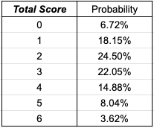
Logic
Homestr
Awaystr
Points
0
0.25
0.5
0.75
Probability / Odds

Slide 3
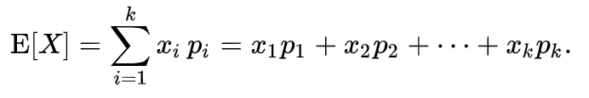
What is the Expected Value (EV)?
The expected value (EV) is an anticipated value for an investment at some point in the future.
In statistics and probability analysis, the expected value is calculated by multiplying each of the possible outcomes by the likelihood each outcome will occur and then summing all of those values.
By calculating expected values, investors can choose the scenario most likely to give the desired outcome.
Let X be a random variable with a finite number of finite outcomes x1, x2, …, xk occurring with probabilities p1, p2, …, pk respectively.
The expectation of X is defined as
Notes:
E(V) = ∑P(Xi)×Xi

Slide 4
Expected Value
From player’s perspective,
EV = probability * win + (1-probability) * loss

Slide 5
Expected Value
From player’s perspective,
EV = probability * win + (1-probability) * loss
In fair market, EV = 0
E.g. OU market, probability (0.6, 0.4), euro odds w/o spread (1.67, 2.5)
Over EV = 0.6 * 0.67 + 0.4 * -1
Over EV = 0
Under EV = 0.4 * 1.5 + 0.6 * -1
Under EV = 0
For point 0 and 0.5, there is no problem because the probability and odds have inverse relationship
However, the situation for 0.25 and 0.75 is different.

Slide 6
.25 Expected Value
3 scenerios (x1, x2, x3)
  X1 = Win (sum of probability > round(point))
  X2 = Win half / lose half (sum of probability = round(point)
  X3 = Lose (sum of probability < round(point))
Use EV to calculate probability of 50/50 market (y1, y2)
Quiz: Try to write down the EV formula if you place $1 on point 2.25 on Over.
  Over probability : y1; Under probability : y2
  Over odds : (1/y1)-1

Slide 7
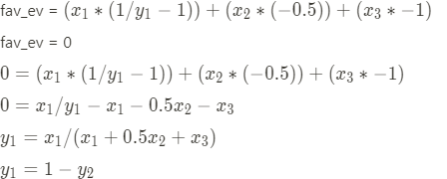
.25 Expected Value
3 scenerios (x1, x2, x3)
  X1 = Win (sum of probability > round(point))
  X2 = Win half / lose half (sum of probability = round(point)
  X3 = Lose (sum of probability < round(point))
Use EV to calculate probability of 50/50 market (y1, y2)
2
1
Notes:
X1 * (1/y1 - 1) + -0.5x2 - 1x3
x1/y1 - x1 = 0.5x2 - x3
x1/y1 = x1 + 0.5x2 - x3
1/y1 = 1 + 0.5x2/x1 - x3/x1
Y1 = 1/ (1 + 0.5x2/x1 - x3/x1)
Y1 = x1 / (x1 + 0.5x2 + x3)
Y2 = 1 - y1

Slide 8
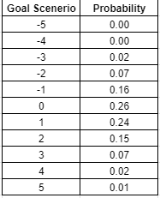
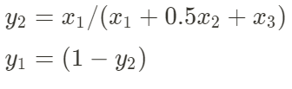
.75 Expected Value
3 scenerios (x1, x2, x3)
  Win (sum of probability > round(point))
  Win half / lose half (sum of probability = round(point)
  Lose (sum of probability < round(point))
Calculate for y2 first instead of y1
Calculate from lose half perspective
Notes:
X1 * (1/y2 - 1) + 0.5x2 - 1x3 = 0
x1/y2 - x1 = 0.5x2 - x3
x1/y2 = x1 + 0.5x2 - x3
1/y2 = 1 + 0.5x2/x1 - x3/x1
Y2 = 1/ (1 + 0.5x2/x1 - x3/x1)
Y2 = x1 / (x1 + 0.5x2 + x3)

